Slide 1

Impact Prediction Project
- By Ruchita Shanbhag

Slide 2
Business Problem:
The objective of the analysis is to predict the impact of an incident raised by the customer.

Slide 3
Project Architecture / Project Flow
1. Data Cleaning Phase- Feature Selection, Conversion Into Dummies
2. Dimensionality Reduction Which Method & Why?
3. Algorithms- Multiple Algorithms Used & Their Accuracies
4. Train & Test Splitting : Sampling Methods for Imbalanced Data
5. Meta Algorithms & Neural Networks- Multiple Meta Algorithms & NN Used & Their Accuracies
6. Cross Validation & Hyper parameter Tuning- Which Method & Why?
7. Deployment Phase

Slide 4
Exploratory Data Analysis (EDA) and
Feature Engineering

Slide 5
Data set details
The dataset is having incidents raised by customers. Which contains an event log of an incident management process extracted from a service desk platform of an IT company.
Dataset contains total 26 features, and 1.4Lac+ records. Out of which 25 features are independent and 'Impact' Feature is output variable.
The Prediction needs to be Classified into 3 Classes:
High Impact
Medium Impact
Low Impact

Slide 6
Exploratory Data Analysis (EDA)
This Phase Includes EDA part for Project Conducted in Tableau.
Each Categorical and Numerical variable is Visualised in Tableau session. Please find Tableau workbook Here
Each Feature is interacting with each other, making whole workbook fully interactive.
Fully Interactive Dashboards were created for both Numerical as well as Categorical Features.
After Analysis of EDA part, the data had some hidden Insights, which are mentioned using stories:

Slide 7
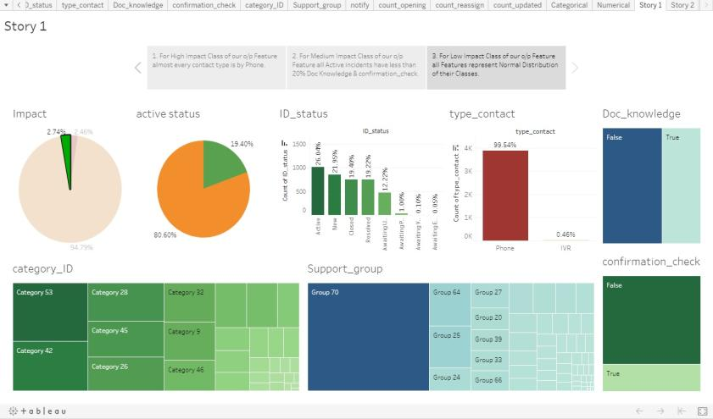
EDA
Story 1

Slide 8
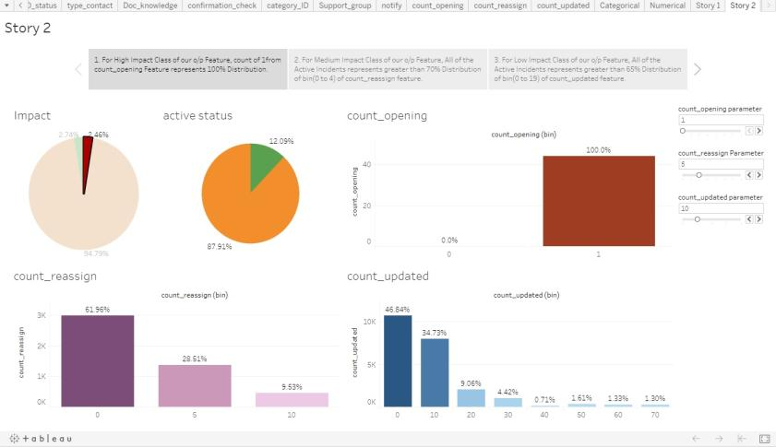
EDA
Story 2

Slide 9
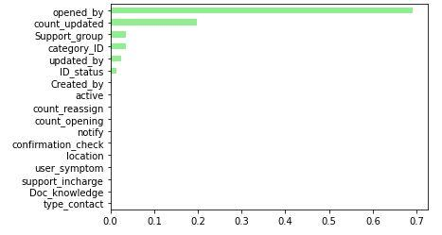
Feature Engineering
Out of 25 Features only top few features were contributing for the output prediction. So only those Features were kept.

Slide 10
Model Building

Slide 11
ML Algorithms
LDA | PCA
1. Decision Tree: Accuracy 0.94 | 1. Decision Tree Accuracy 0.94
2. Random Forest Accuracy 0.95 | 2. Random Forest: Accuracy 0.95
3. Support Vector Classifier Accuracy 0.95 | 3. Support Vector Classifier Accuracy 0.95
4. Gaussian NB Accuracy 0.92 | 4. Gaussian NB Accuracy 0.90
5. KNN Accuracy 0.95 | 5. KNN Accuracy 0.95

Slide 12
Meta Algorithms
LDA | PCA
1. Voting Classifier Accuracy of Voting Classifier: 0.947 | 1.Voting Classifier Accuracy of Voting Classifier: 0.954
2. Bagging Classifier Accuracy of Bagging Classifier: 0.949 | 2. Bagging Classifier Accuracy of Bagging Classifier: 0.954
3. AdaBoost Classifier Accuracy of AdaBoost Classifier: 0.949 | 3. AdaBoost Classifier Accuracy of AdaBoost Classifier: 0.954
4. XGBoost Classifier Accuracy of XGBoost Classifier: 0.953 | 4. XGBoost Classifier Accuracy of XGBoost Classifier: 0.951

Slide 13
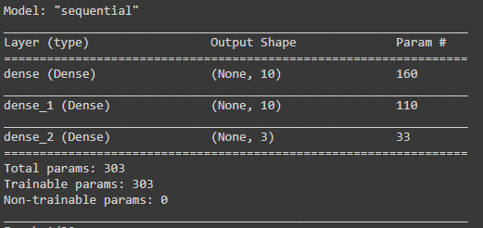
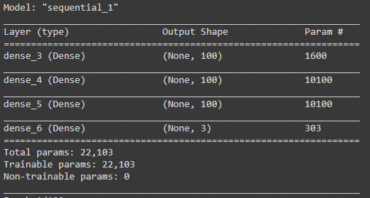
Neural Networks Model Building
NN Model 1
303 Params
NN Model 2
22,103 Params

Slide 14
Model Deployment using Flask On AWS
Model is Deployed on AWS Cloud & Heroku Platform with Flask Framework.
AWS: http://ec2-18-219-185-230.us-east-2.compute.amazonaws.com:8080/
Heroku: https://impact-prediction-deployment.herokuapp.com/

Slide 15
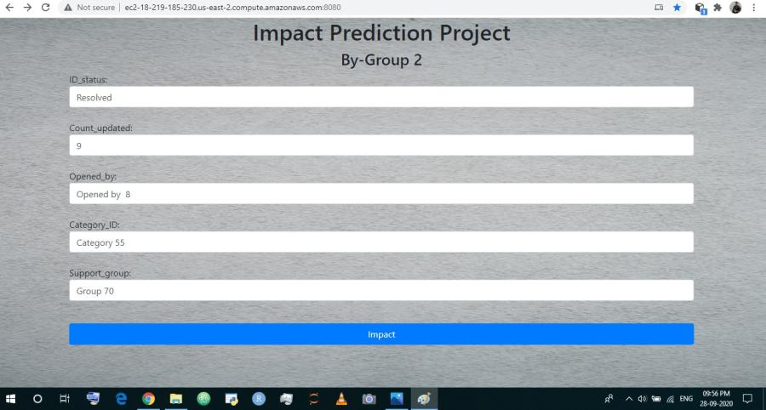
Home Template

Slide 16
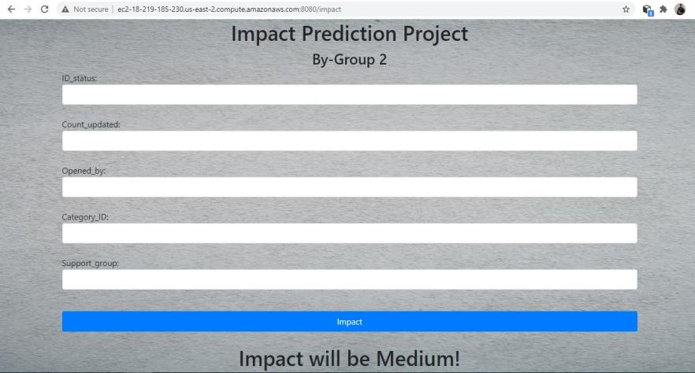
Prediction Template

Slide 17
Challenges faced?
In Deployment Phase, Collection of User input Values from Home HTML Template Form and making operations on them in Backend.
Integration & Setting up of EC2 Instance on AWS.
How did you overcome?
To make Operations on User Input values we generated separate Encoder Pickel file for each Categorical Variable. Then Integrated same with the Backend to Successfully Encode and Decode Those Categorical Variable.
Wide Variety of server were available, we used Linux server as it is popularly known for its simplicity. Then performed operations using Putty, PuttyGen and WinSCP Software's.

Slide 18
Thank you!!

